Slide 1
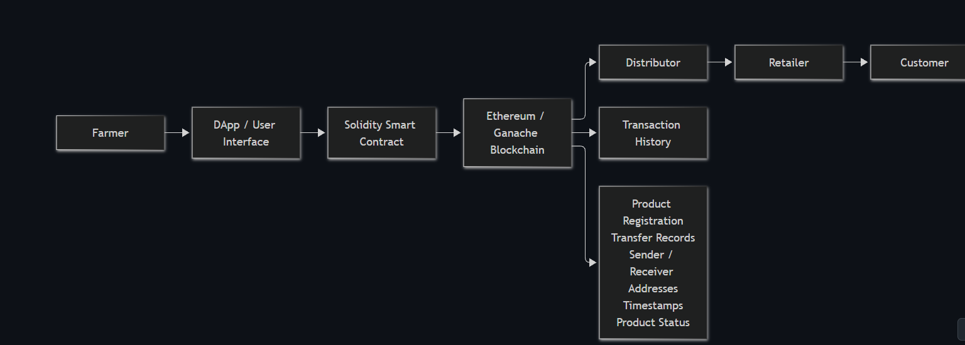
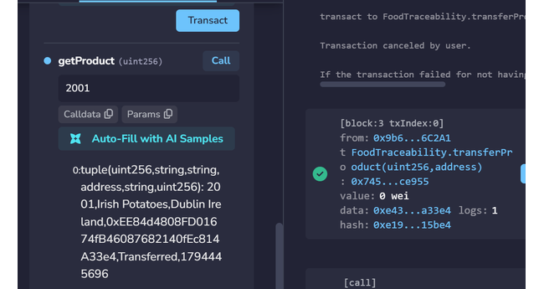
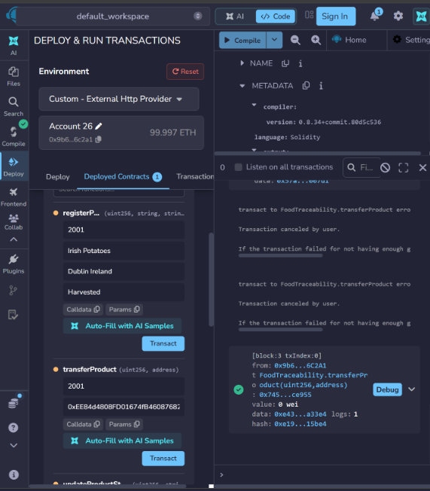
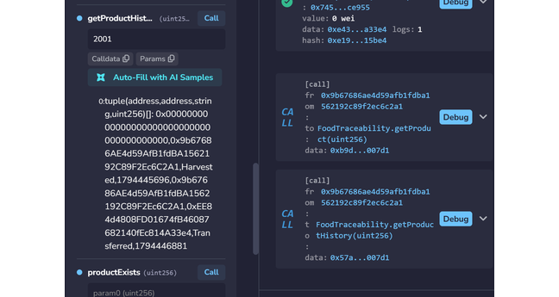
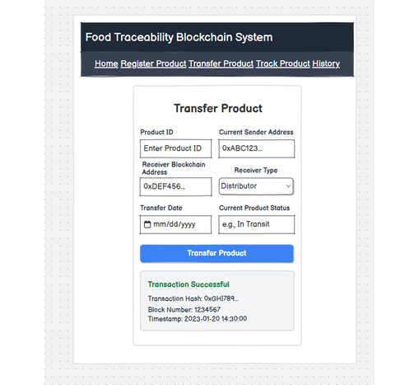
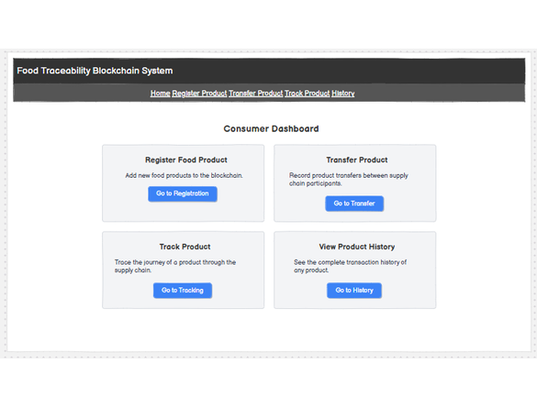
FOOD TRACEABILITY BLOCKCHAIN SYSTEM
Design, Solidity Implementation and Local Blockchain Testing
Eusha Ibne Nur Sami Distributed Digital Transactions -ca1
02 BLOCKCHAIN ARCHITECTURE
03 IMPLEMENTATION AND TESTS
04 VERIFICATION AND FINDINGS
01 PROJECT OVERVIEW
Solidity 0.8.34 was compiled in Remix with the Paris EVM target, then deployed to Remix VM and Ganache over a local HTTP provider.
Food supply-chain records are often scattered across farms, distributors and retailers. This prototype stores product registration and ownership movements through a Solidity smart contract rather than relying on one organisation’s records.
The diagram below follows the draw.io design supplied for this project.
The Ganache deployment created a contract instance. Product 2001 was registered in Block 2. A valid transfer was confirmed in Block 3, changing its current owner and the status to “Transferred”.
PROJECT OBJECTIVES
DApp / UI
Ganache
TEST RESULTS
Register uniquely identified products.
Transfer ownership between wallet addresses.
Retrieve product details and movement history.
Reject unauthorised or self-directed transfers.
Network
Action
Result
OWNER AND HISTORY VERIFICATION
Remix VM
Product 1001 · Gala Apples
Registered
Remix VM
Transfer to Account 2
Passed
Remix VM
Unauthorised previous owner
Rejected
Ganache
Product 2001 · Irish Potatoes
Block 2
Solution & Security
Ganache
Ownership transfer
Block 3
The farmer registers a food product; ownership then passes to authorised supply-chain participants. Ganache provides the local blockchain, while Remix interacts with the Solidity contract.
Signed Ethereum transactions establish the calling account; cryptographic hashes help protect record integrity. Owner-only checks restrict transfers and status changes.
Ganache
get Product / getProduct History
Verified
TRANSFER EVIDENCE
SOLIDITY SMART CONTRACT
Five core operations:
registerProduct() · transfer Product()
update Product Status() · getProduct()
getProduct History()
The contract saves details about the items and their movement history, and you can find this information by looking for the item number..
BALSAMIQ INTERFACE PROTOTYPE
DESIGN AND TEST WORKFLOW
CONCLUSION AND LIMITATIONS
Registration, restricted transfers and retrievable history worked in the local test environment. The system remains a prototype: source-data accuracy, privacy, costs, scalability and a working front end need further work.
DEBUGGING AND VALIDATION
The first Ganache transfer used the same address for sender and receiver. Remix warned that gas estimation would fail, consistent with the contract’s self-transfer protection.
After selecting a different receiver, the transfer succeeded. An earlier Remix VM attempt by the previous owner was also rejected.
REFERENCES · HARVARD STYLE
Ethereum Foundation (n.d.) Ethereum developer documentation. Available at: ethereum.org/en/developers/docs/ (Accessed: 12 November 2026).
Solidity Team (n.d.) Solidity documentation. Available at: docs.soliditylang.org (Accessed: 12 November 2026).
Remix Project (n.d.) Remix IDE documentation. Available at: remix-ide.readthedocs.io (Accessed: 12 November 2026).
Truffle Suite (n.d.) Ganache. Available at: archive.trufflesuite.com/ganache/ (Accessed: 12 November 2026).
Figure : Balsamiq traceability view used to plan product-history retrieval.
Figure: Transfer-product wireframe (design prototype; no deployed front end).

